Slide 1

StarLink
Presented by: Under the Guidance of:
John Nixon: 2GI19IS016 Prof. Rakesh Kadkol
Hrutuja Patnekar: 2GI19IS017

Slide 2

What is StarLink?

Slide 3
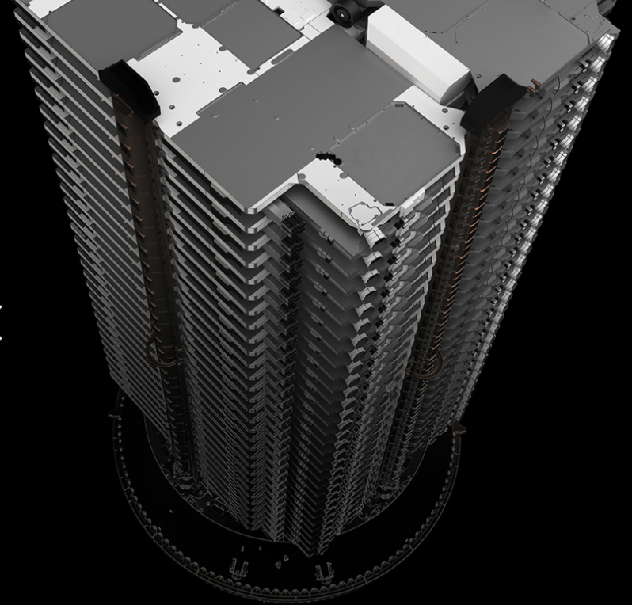

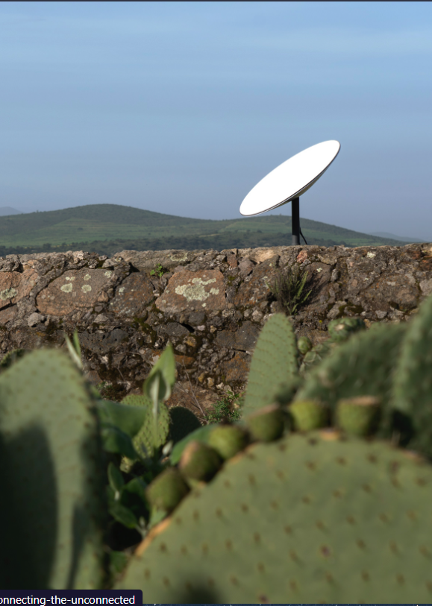
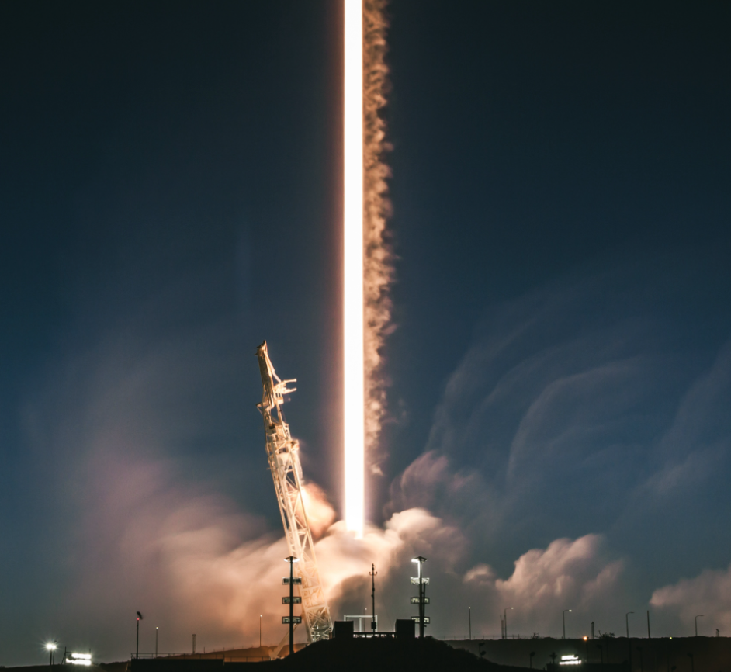
Why StarLink ?
Less mass, more compact
Autonomous Collision Avoidance
Star Tracker
Optical Space Lasers
Ion Propulsion Systems
Singular Solar Array

Slide 4
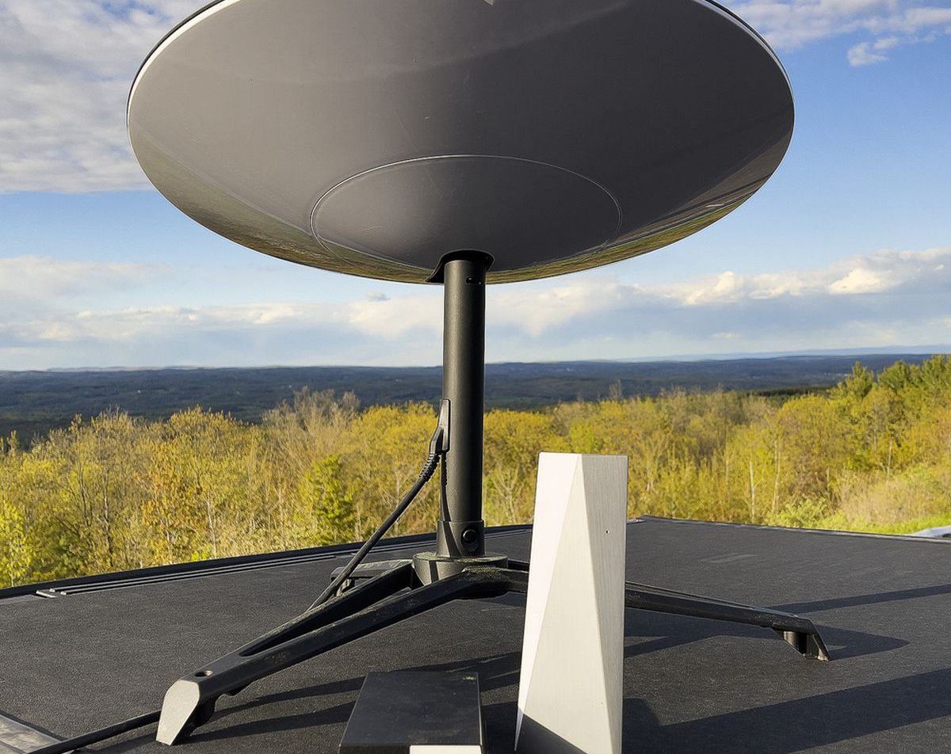
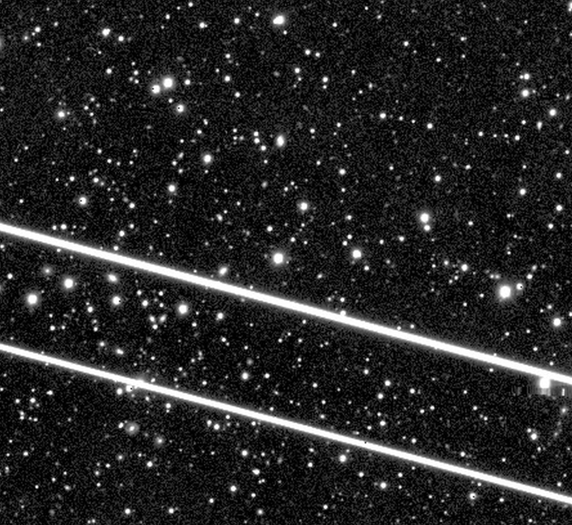
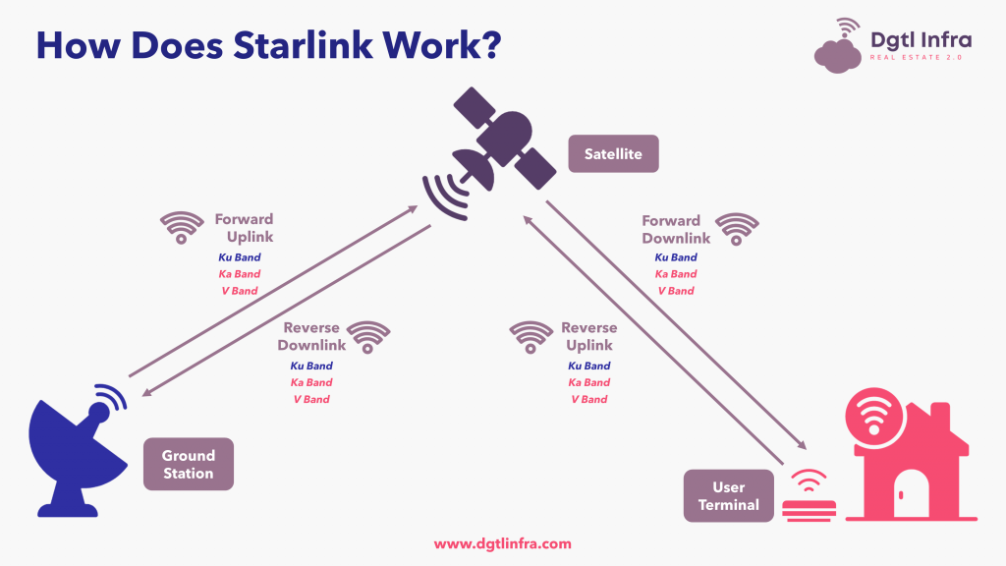

How does StarLink Work ?

Slide 5
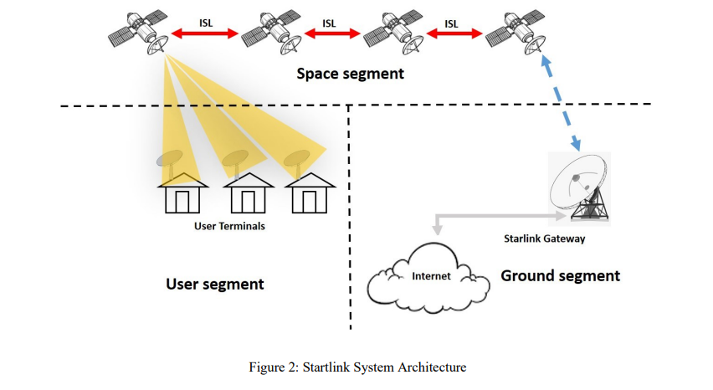

Slide 6
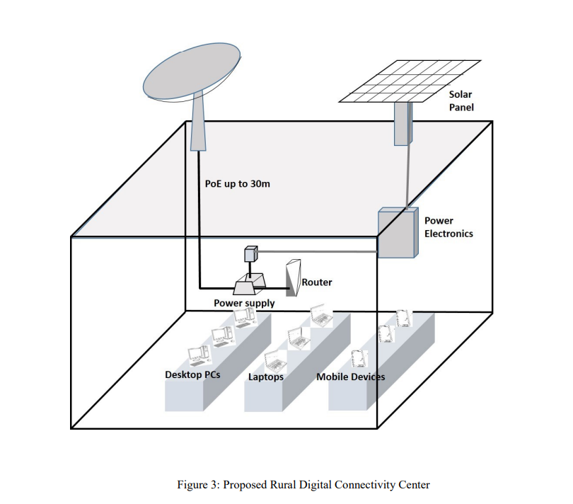

Slide 7

Starlink Satellite Map as of 21st May 2021

Slide 8


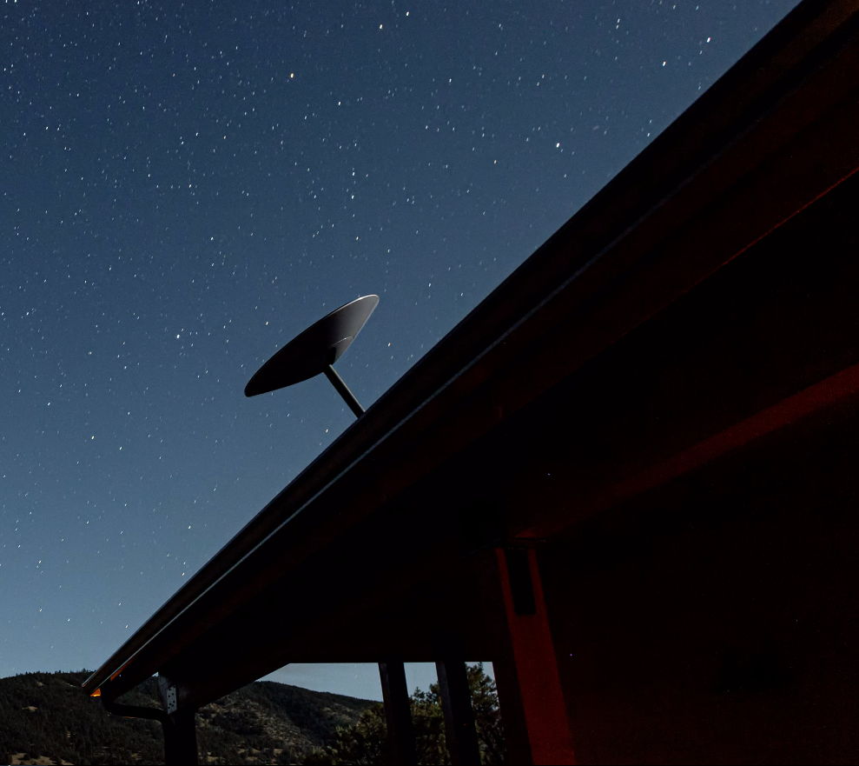
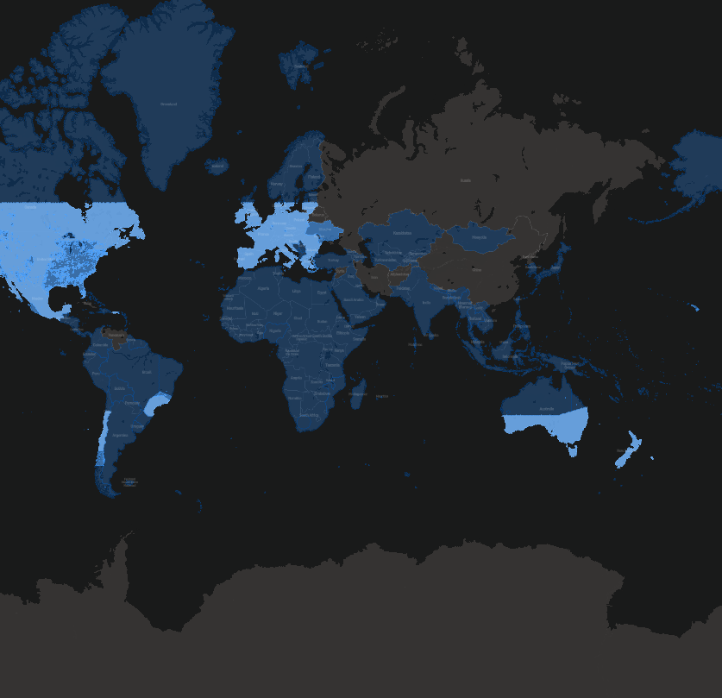
Summary
Starlink is a satellite internet constellation operated by SpaceX, providing satellite Internet access coverage to 32 countries.
Starlink provides high-speed, low-latency broadband internet across the globe. Within each coverage area, orders are fulfilled on a first-come, first-served basis.

Slide 9

Thank You
Thank You!

